Slide 1
EMERGING CAREER OPTIONS FOR A FAST PACED WORLD
THE WORLD BEYOND DOCTORS AND ENGINEERS

Slide 2
POINTS TO PONDER

Slide 3
The best way to predict future is to create it!
While choosing a stream after 10th, a training course or a career one should know one’s own abilities, interests, aptitudes and personality.
Besides these one should gather information regarding different career options, the eligibility criteria, the premier institutions/universities, and the market demands
Vocational interest : One’s own pattern of preferences, aptitudes, likes and dislikes for a given vocational area

Slide 4
Aptitude : Innate ability of an individual to learn and excel in a particular career. Aptitude can be expanded through education and training.
Personality : Certain occupations and workplaces may attract certain characteristics – an employer’s job requirements or workplace culture often necessitate specific personality traits. These traits can be characteristic of particular personality types
Education : Previous academic and behaviour records give an insight into suitable career options for an individual
Values and Beliefs : personal ideals, motives, and beliefs that help you identify what's most important in your professional career

Slide 5
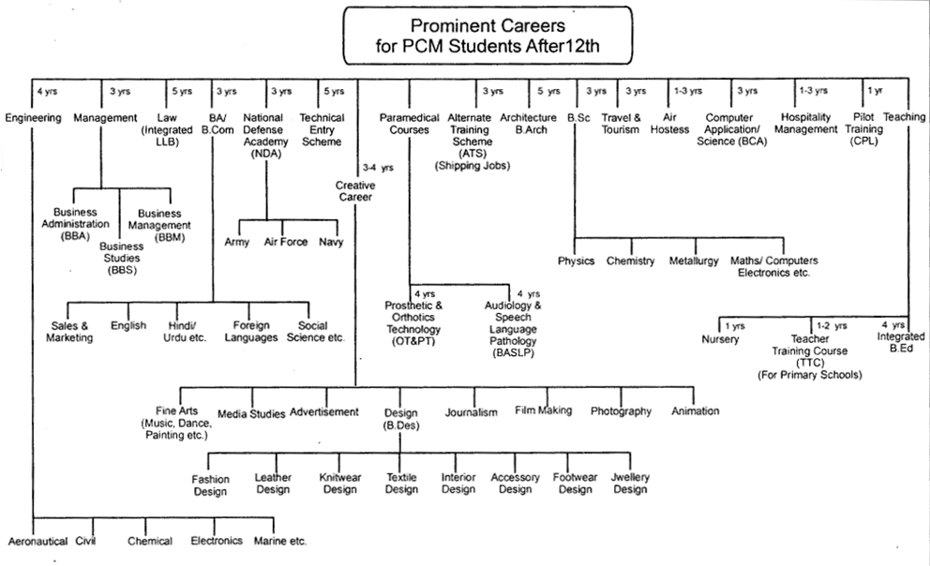

Slide 6
EMERGING CAREERS beyond engineering
Landscape Architecture and Urban Planning
Actuarial Science
Data Science
Industrial Science
Forensic Science
Cartography
Astronomy

Slide 7
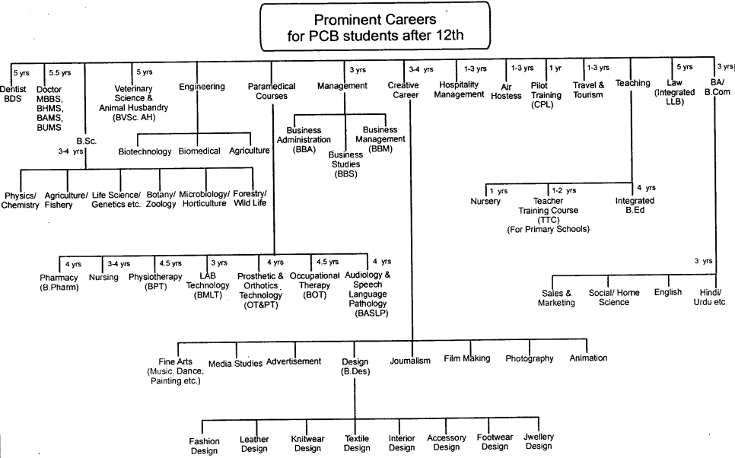

Slide 8
Emerging careers for pcb students
Genetics
Clinical Research
Food Science
Public Health
Physiotherapy
Environmental Science
Biotechnology
Pharmacy
Agriculture

Slide 9
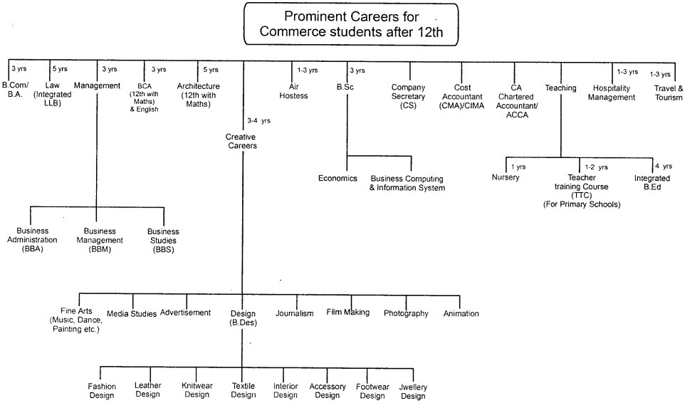

Slide 10
emerging careers in commerce
Certified Financial Analyst
Investment banker
Human Resource Manager
Marketing Manager
Banking
Tax consultant
Economist

Slide 11
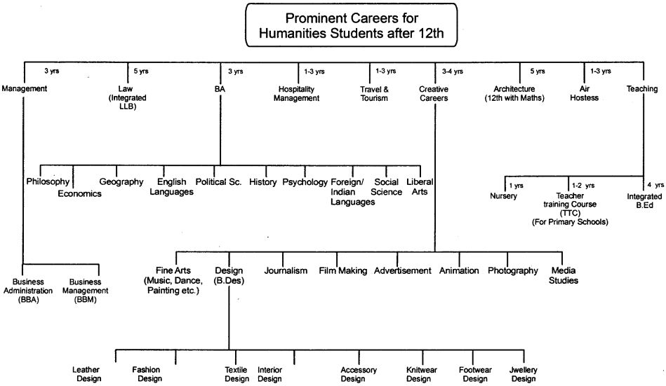

Slide 12
Trending careers in humanities stream
Foreign Language Experts
Psychologist/counsellor
Lawyer
Journalist
International Relations Specialist
Art Director
Event Manager
Hospitality Professional
Digital Marketing Professional
Artist
Content Creator
Baking Professional
Fashion design
Professional Photographer

Slide 13
Steps to choose the right subjects
Self awareness exercise with goal setting
Reflection on previous academic and personal achievements
Consideration of special talents and skills
Gauging your aptitude for a certain subject
Brainstorming – coming up with as many career choices as possible in your area of interest
Eliminating the ones that are not plausible
Discussion with subject experts and parents

Slide 14
CONTD.
Extensive research on job prospects, eligibility criteria, institutions and universities offering the course, entrance examinations and coaching options, etc
Make Plan A and Plan B (In line with your interest, aptitude, and skills)
Elimination of any dilemma or confusion through counselling
Final decision

Slide 15
STREAM | COMPULSORY SUBJECTS | OPTIONAL SUBJECTS
Science with Maths | 1)English, 2)Physics, 3)Chemistry, 4)Maths | Physical Education(Ph.Ed) Computer.Science Economics Psychology
Science with Biology | 1)English, 2)Physics, 3)Chemistry, 4)Biology | Physical Education(Ph.Ed) Computer.Science Economics Psychology Hindi
Commerce | 1)English, 2)Accountancy, 3)Business Studies 4) Economics | Maths Physical Education(Ph.Ed) Informatics Practices (I.P) Psychology Hindi
Humanities | 1)English, 2)History, 3)Geography | Option 1(Subject- 4) Political Science Economics Physical Education | Option 2(Subject -5) Psychology Informatics Practices(I.P) Home science Hindi

Slide 16
RESOURCES
National Digital Library https://ndl.iitkgp.ac.in/testprep/career
AWES Colleges https://www.awesindia.com/college.aspx-
NDA https://www.nda.nic.in/
Career360 https://www.careers360.com/

